Slide 1
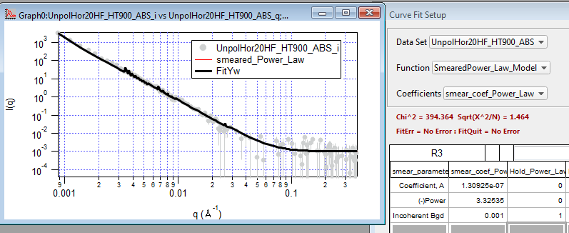
IGOR Raw Data

Slide 2
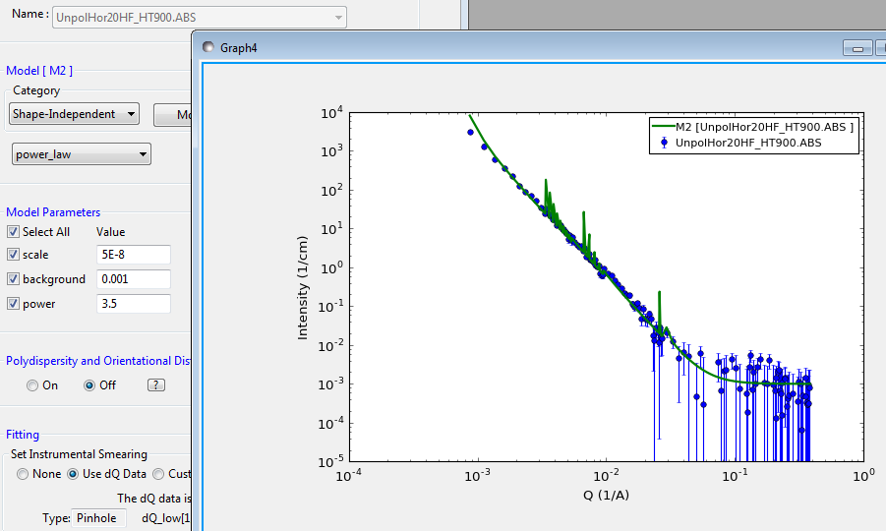
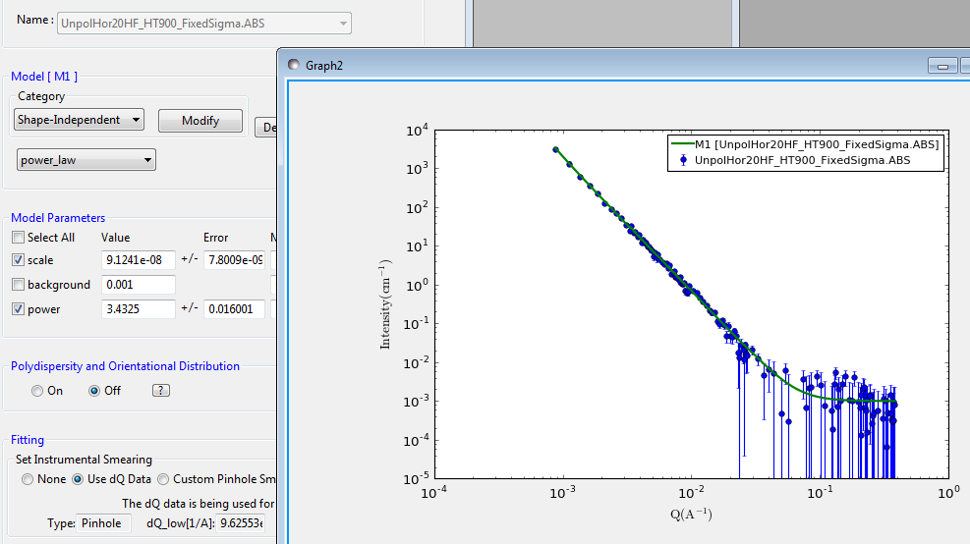
SasView Raw Data
SasView SigmaQ / 2.35

